Slide 1

IoT BASED SMART HOME USING ESP32 DEVELOPMENT KIT
Project Associates(Batch 9)
P. Srinu (19A81A04A1)
V. N. V. Sushmanth (19A81A04B5)
P. Yaswanth (19A81A04A3)
R. Nithin (19A81A04A5)
U. Samuel (19A81A04B4)
Under the esteemed guidance of
Smt. Y. Sujatha M. Tech
Sr. Assistant Professor
SRI VASAVI ENGINEERING COLLEGE
(AUTONOMOUS)
DEPARTMENT OF ECE

Slide 2
Contents
Abstract
Introduction
Literature Survey
Proposed Model
Components
Results
Conclusion and Future scope
References

Slide 3
Abstract
This project is based on IoT Home Automation System. The aim of the project is to control all the appliances in a home like fan, light, motor etc., using Mobile (ESP RAINMAKER APP), Manual switches, IR Remote and Sensors.
ESP32 microcontroller is the core of the project which has inbuilt Wi-Fi and Bluetooth.
ESP rainmaker is an application that provides free cloud services and establish connections with voice assistance and it provides automation based on scheduling.
Sensors like temperature, gas, etc., detect room atmosphere and send alerts to mobile and take necessary actions. PIR motion sensor is used to auto turn ON/OFF the appliances by detecting whether human has moved in or out of the room.

Slide 4
Introduction
Smart Home is collaboration of technology and services through a network for better quality living.
A smart home allows the entire home to be automated and therefore provide ease and convenience to everyday activities in the home.

Slide 5
LITERATURE SURVEY
SI.NO | PROJECT NAME | AUTHOR | PROPOSED YEAR / JOURNAL | DRAWBACK
1 | IoT Enabled Home Automation System Comprehending the User Experience Based on Their Pattern Usage | Saurabh Anand, Anurag Awasthi, Akash Verma, Zaid Ahmad Khan, Ashfaq Alam Khan | 2020 IEEE Xplore | No manual operations are possible
2 | Home Automation using IoT | Meena Kasbekar, Nida Khan, Atharva Kadam and Prof.Milind Gajare | 2021 IJARSCT | No manual operations are possible

Slide 6
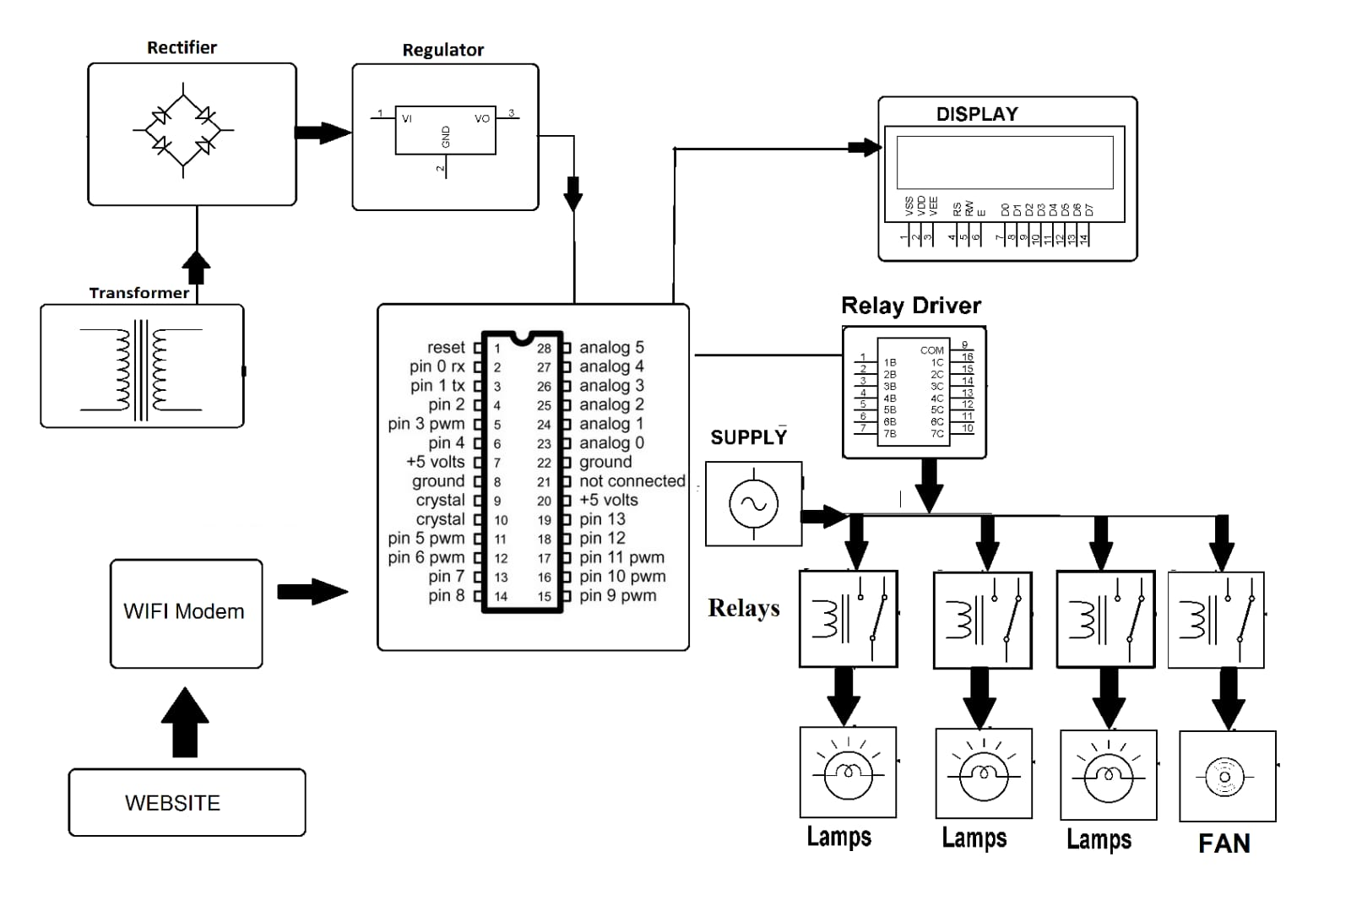
EXISTING MODEL -1

Slide 7
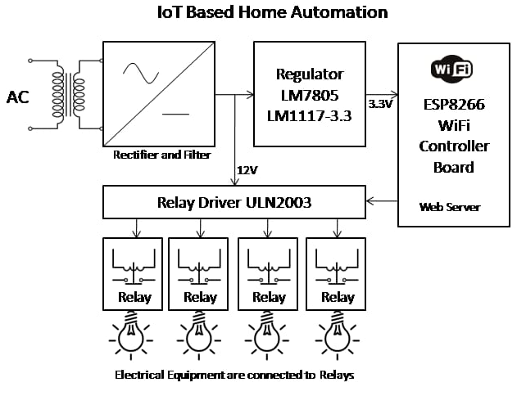
EXISTING MODEL -2

Slide 8
Proposed Model

Slide 9
Proposed Model(cont.)
For Room(node1)
Connected to Wi-Fi

Slide 10
Proposed Model(cont.)
For Kitchen(node2)
Connected to Wi-Fi

Slide 11
Node 1 Circuit

Slide 12
Node 2 Circuit

Slide 13
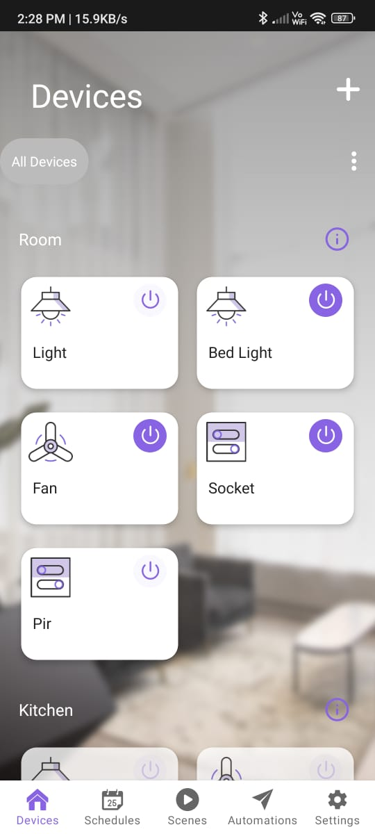
Components
ESP32 Microcontroller
Relay Module
Passive Infrared Sensor
IR receiver – IR Remote
DHT11 Sensor
Gas Sensor (MQ-6)
Buzzer
Rainmaker App

Slide 14
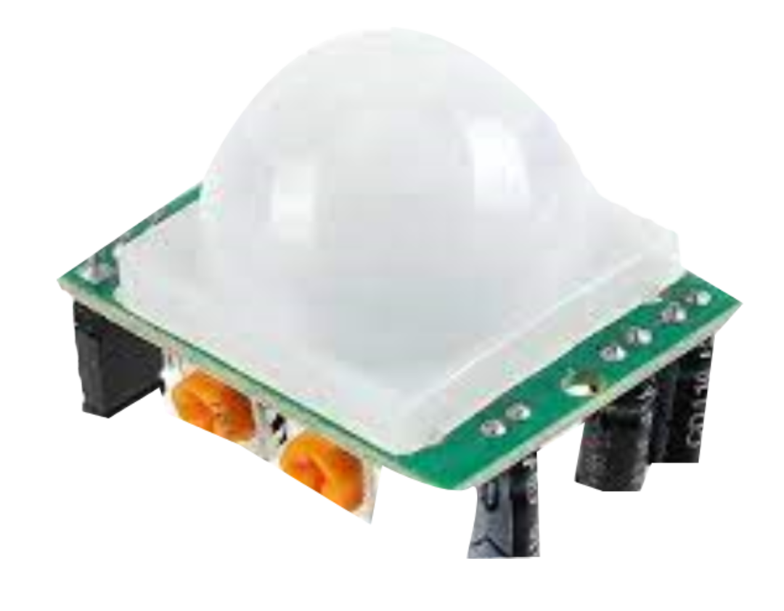
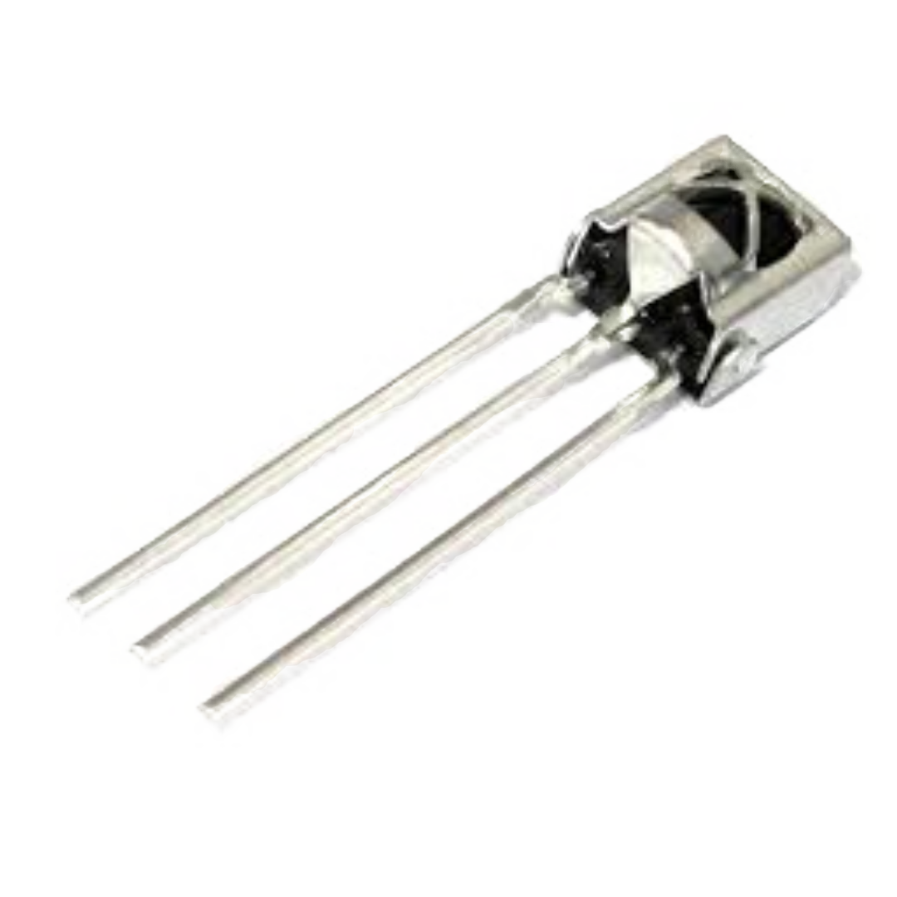
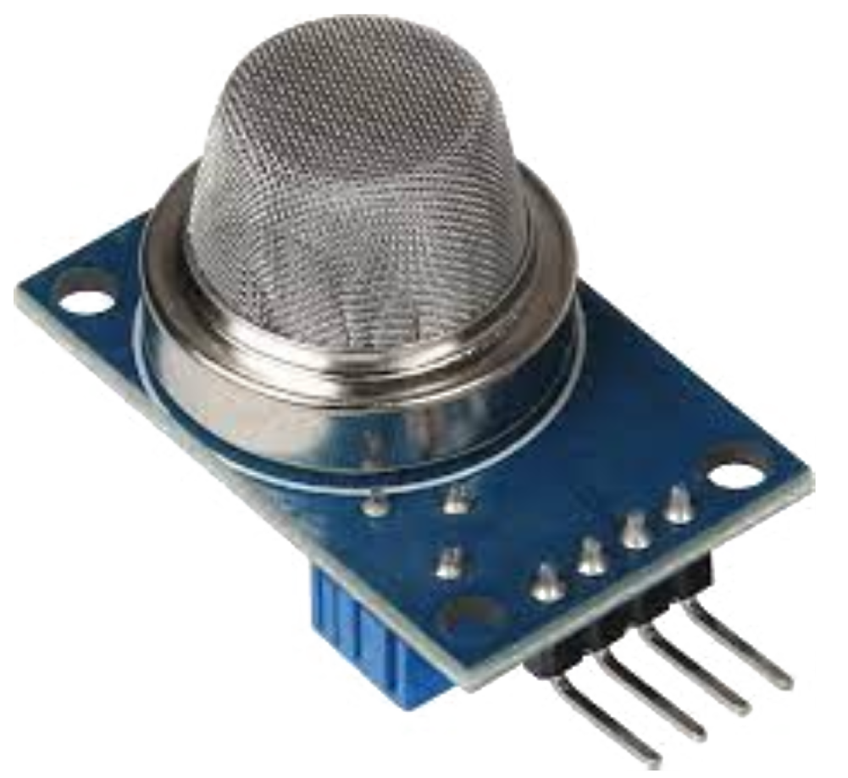
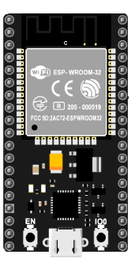
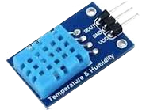
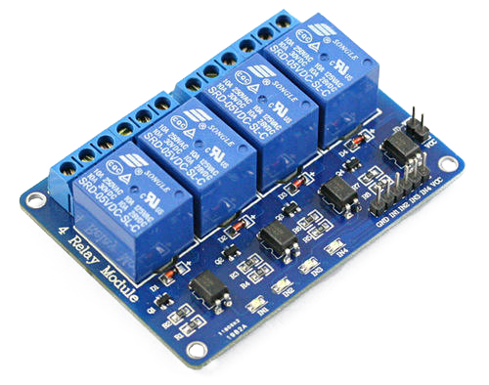
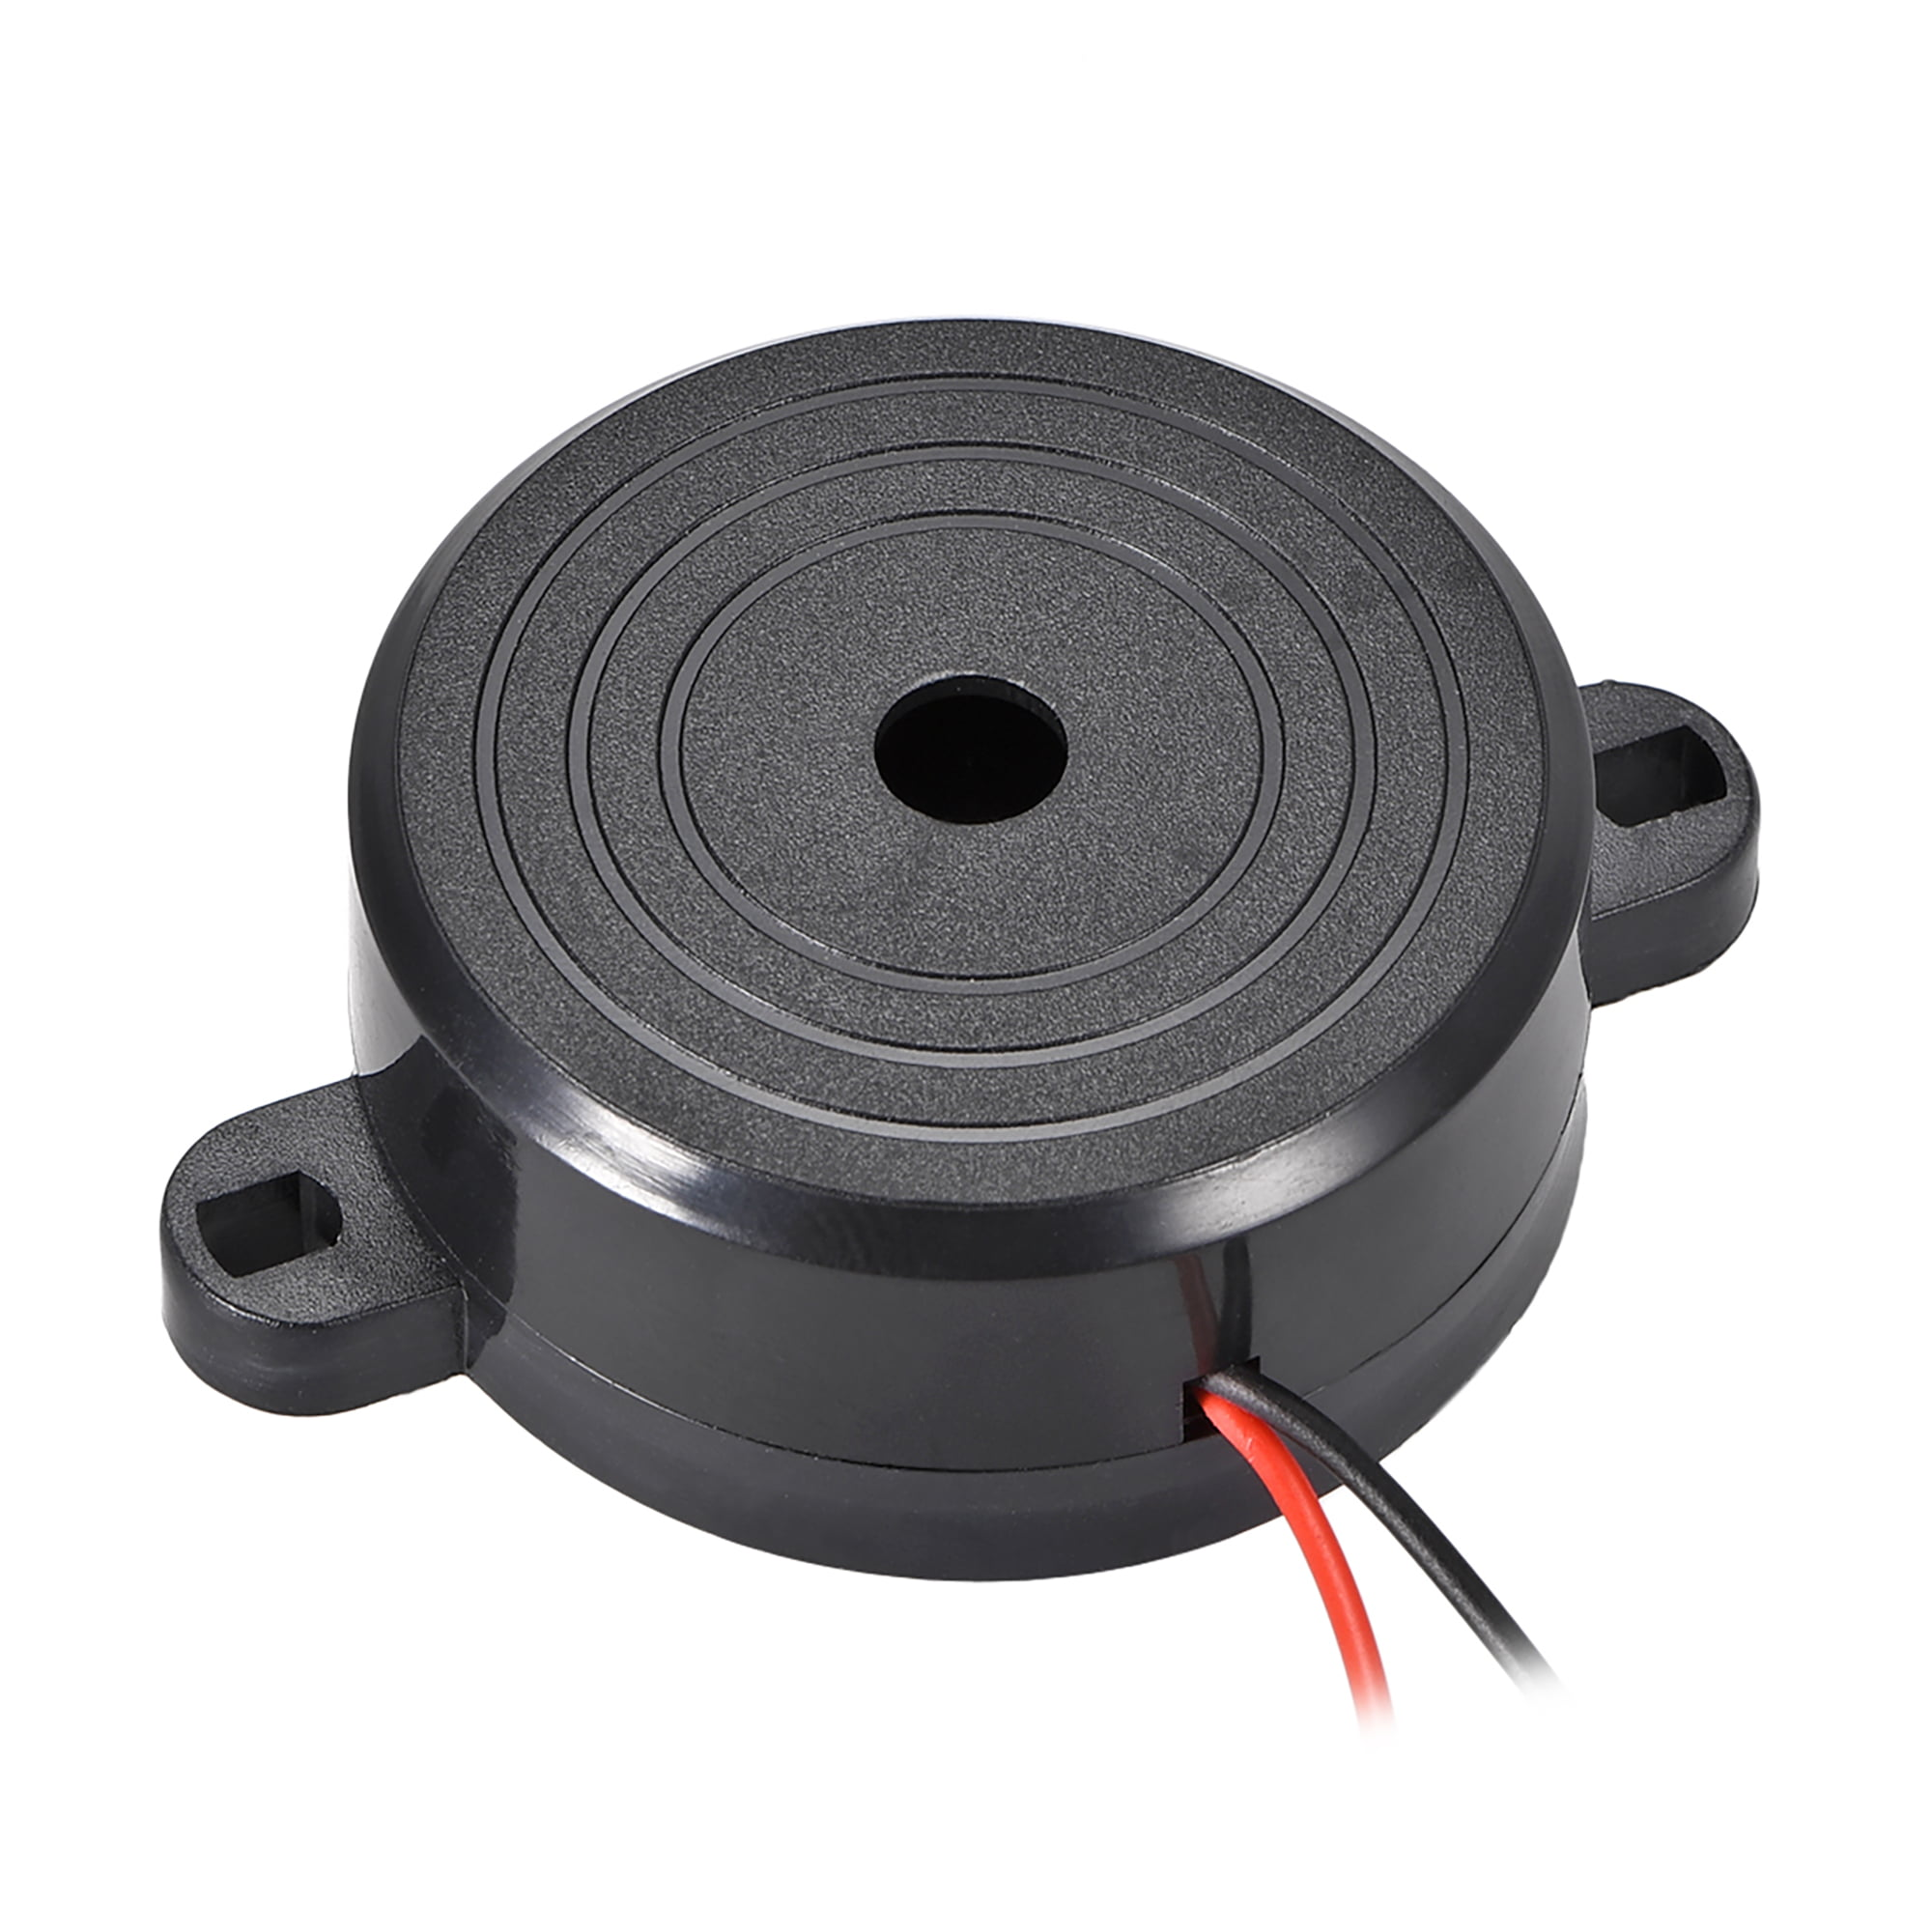
IR Receiver
Gas Sensor (MQ-6)
PIR Sensor
DHT11 Sensor
Buzzer
Relay Module
ESP32 Microcontroller

Slide 15
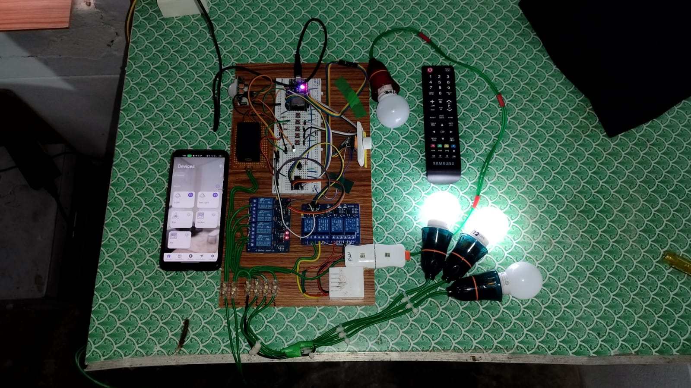
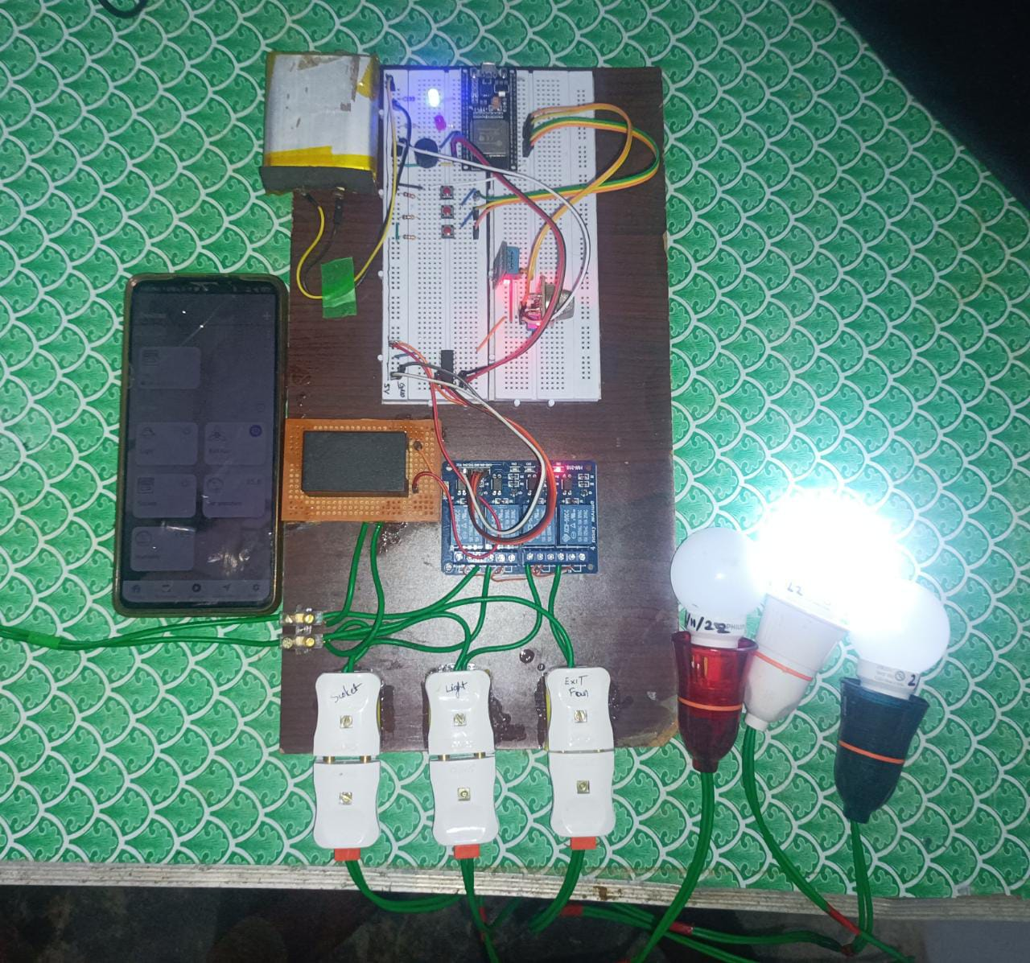
Results
Node 1 (For Room)
Node 2 (For Kitchen)

Slide 16
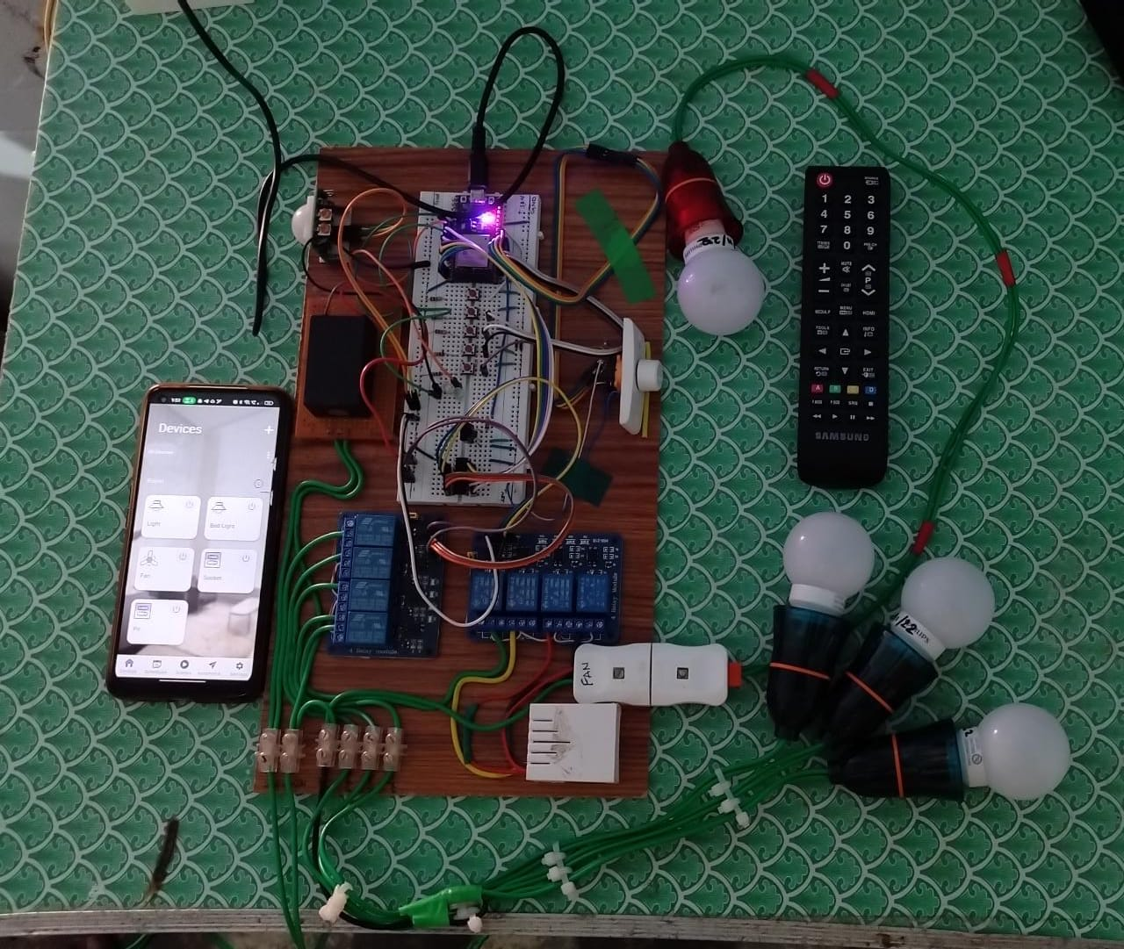
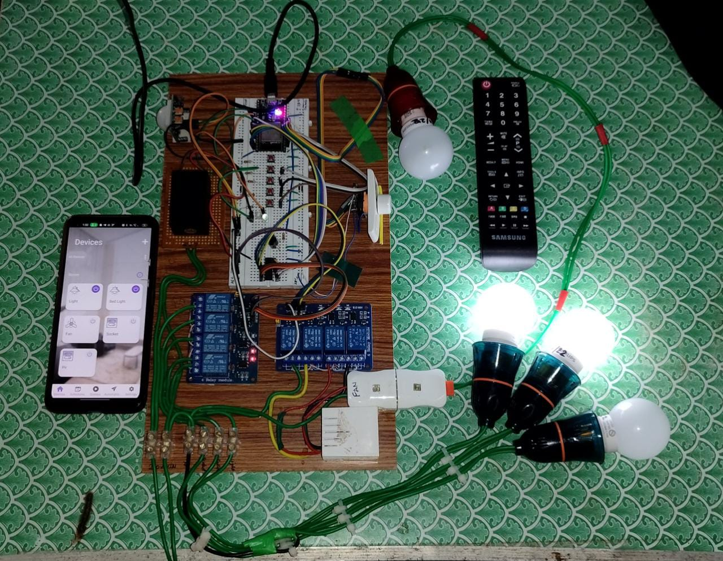
Results
All devices Off state
Bed light and Light ON

Slide 17
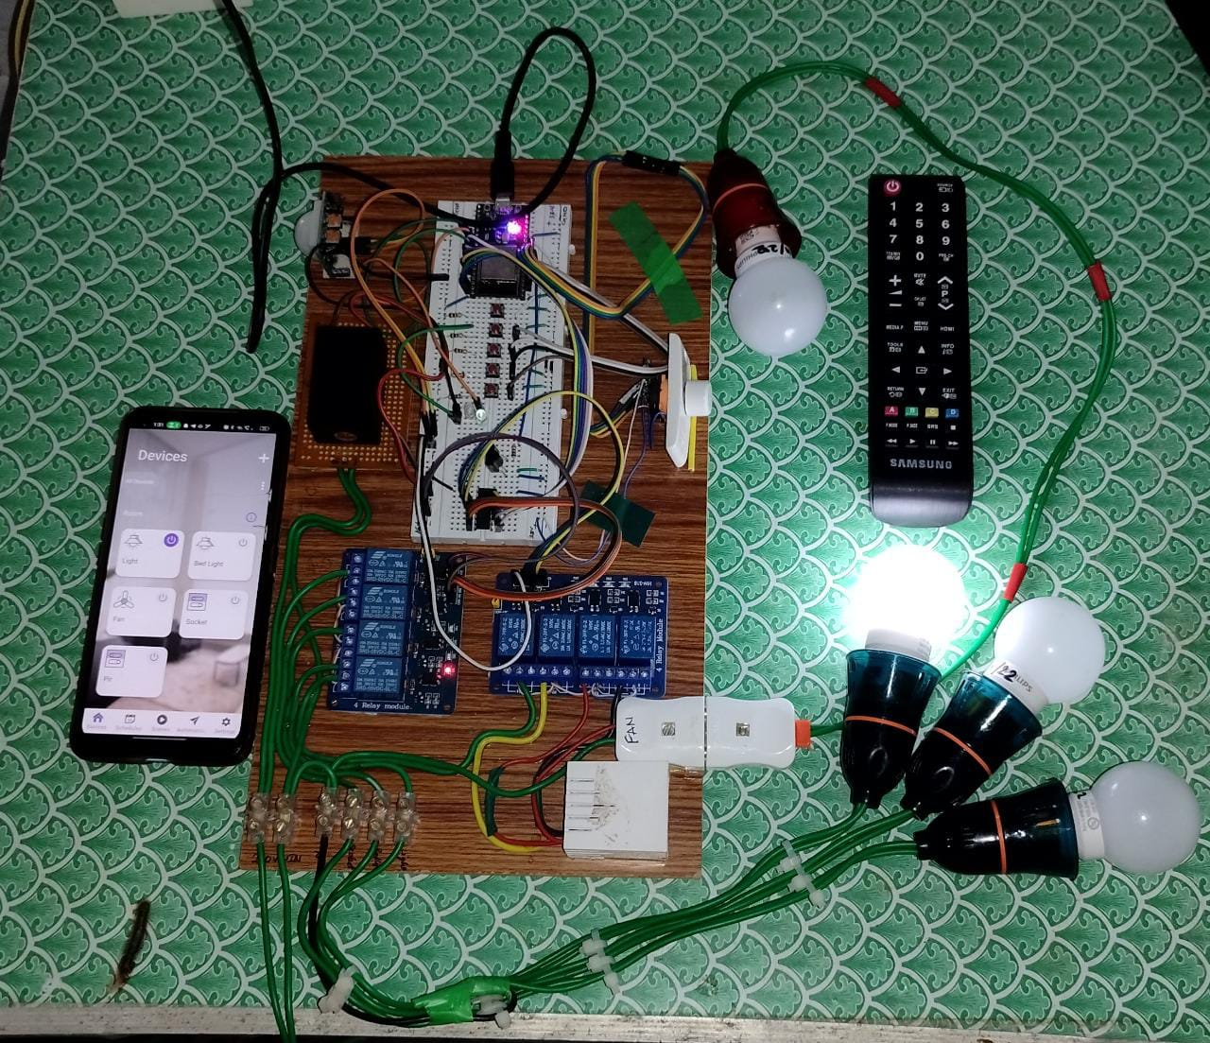
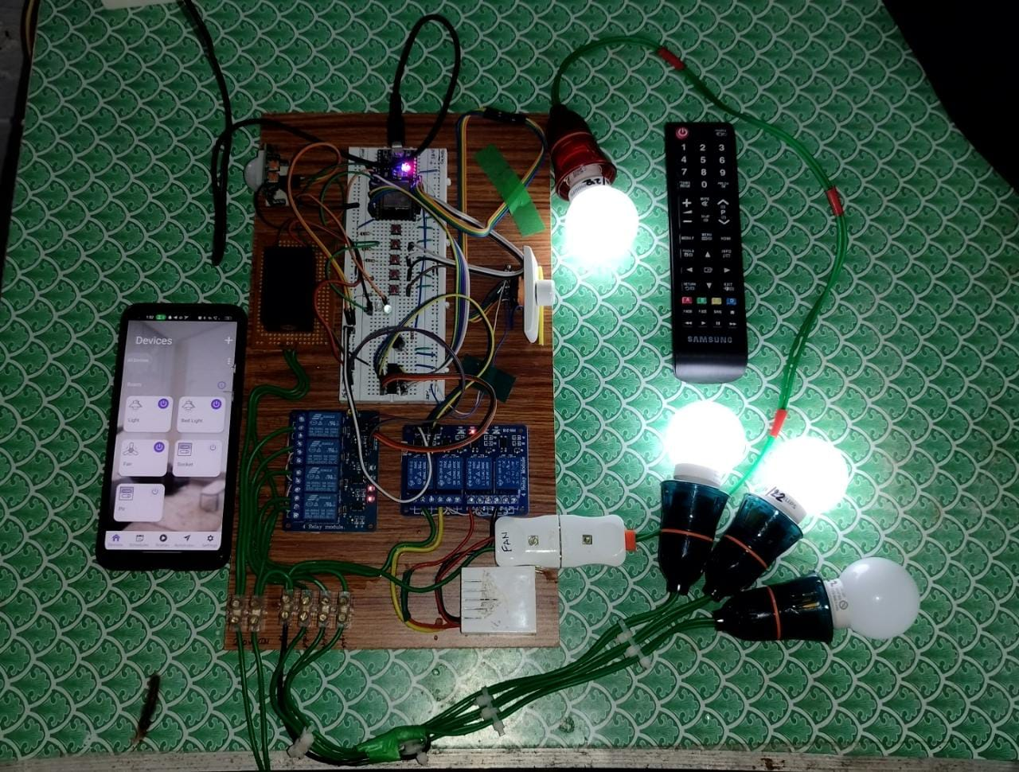
Results (cont.)
Light On
Light, Bed light and Fan On

Slide 18
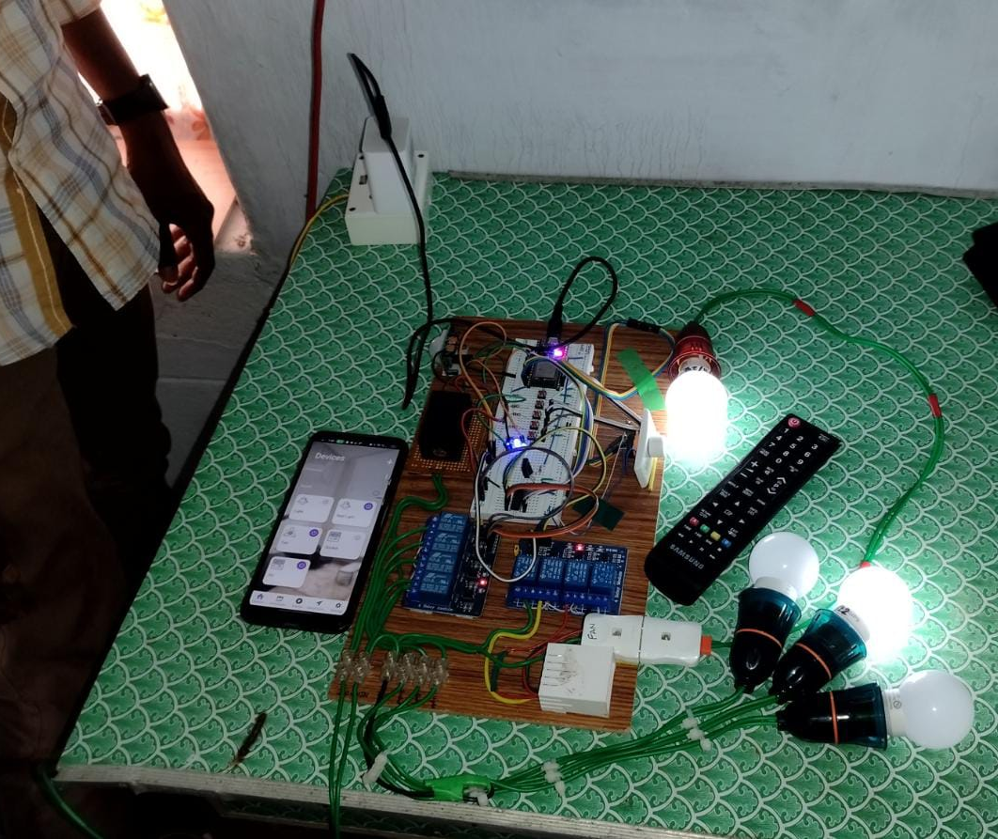
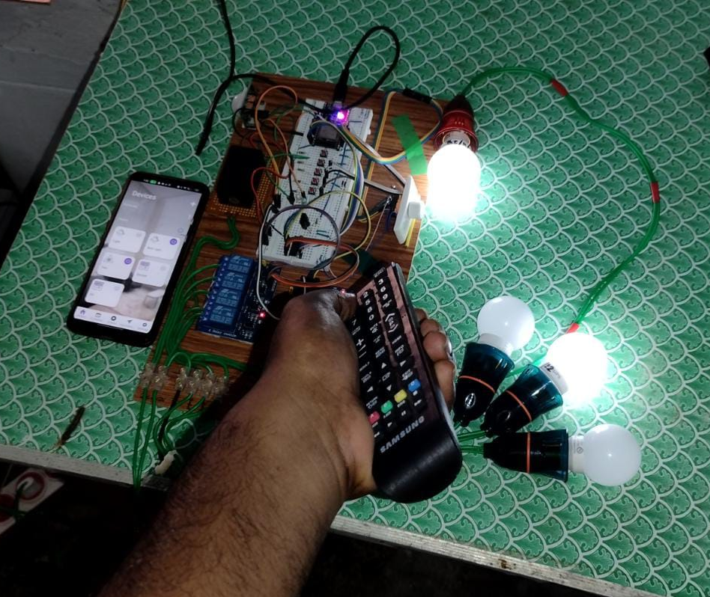
Results (cont.)
PIR Operation
IR Operation

Slide 19
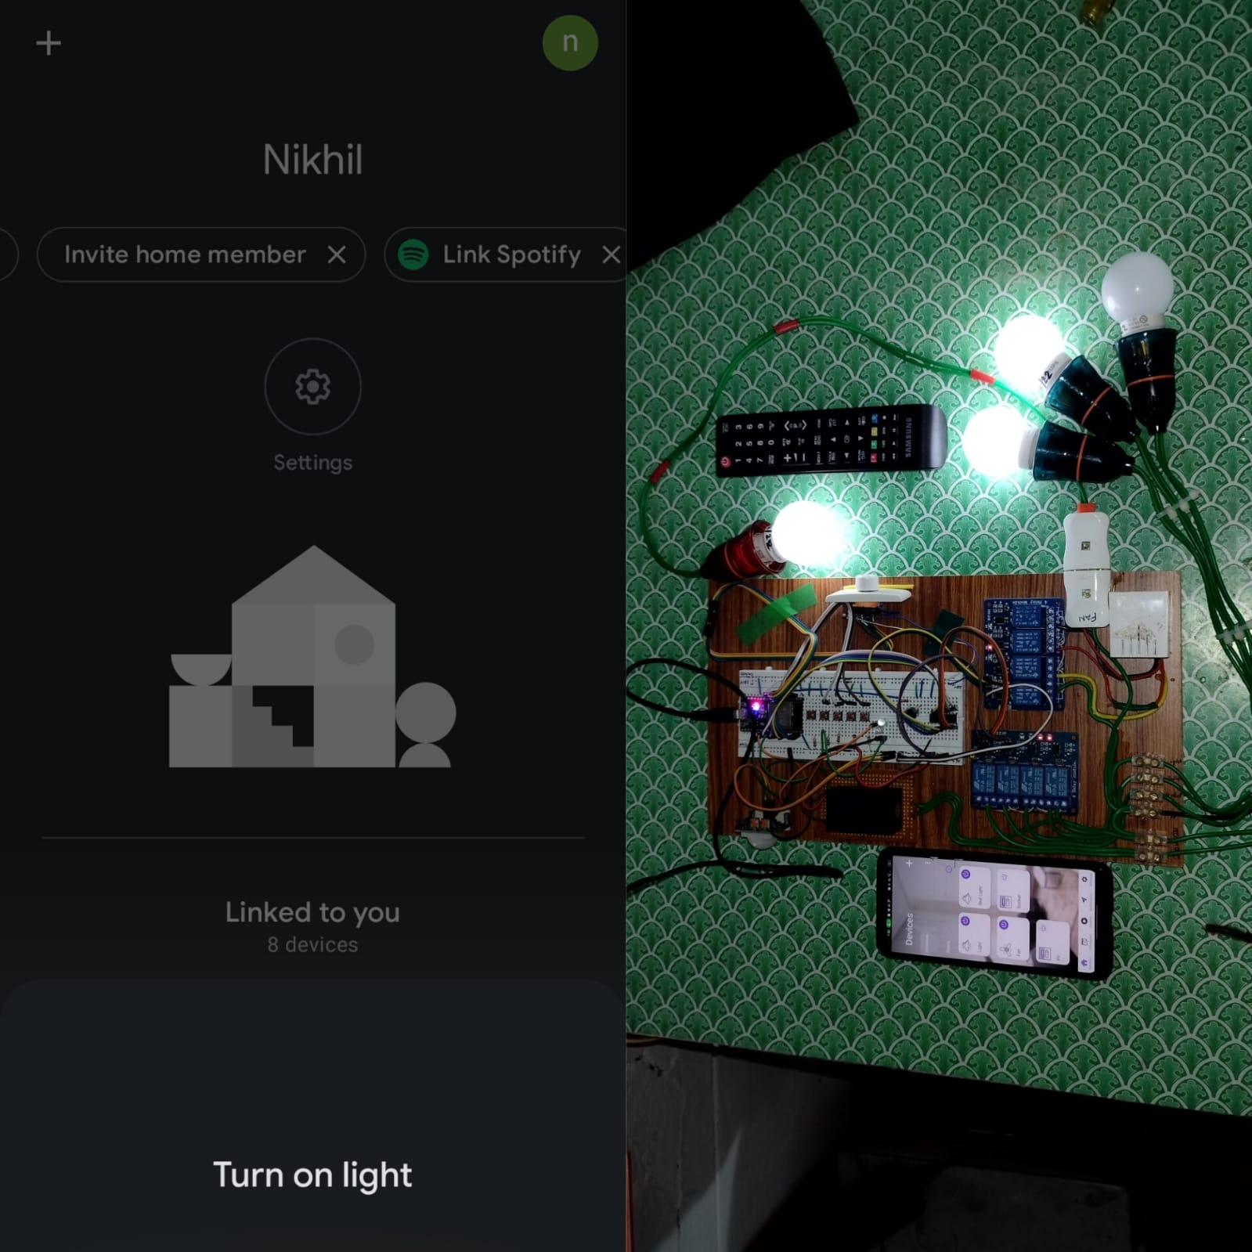
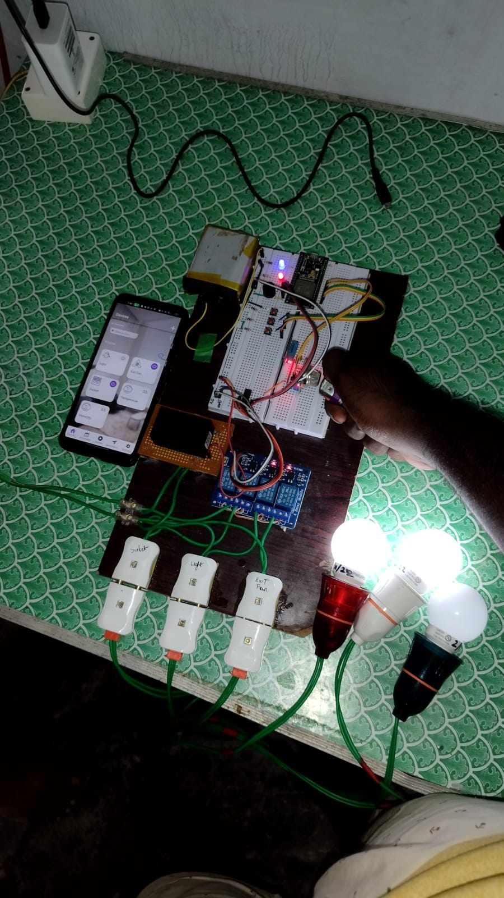
Results (cont.)
Voice assistant
Gas Sensor

Slide 20
Conclusion and Future Scope
The home automation system has been experimentally proven to work well by connecting sample appliances to it and the appliances were successfully controlled from a mobile device. In future this product has a potential demand in marketing and it may seen in every house hold.
The project can be further extended with adding some sensors like ultrasonic sensor, moisture sensor and communication devices like lora, ZigBee to archive full automation for water monitoring and irrigation system.

Slide 21
References
Mohaiminul Islam, Md. Nahiyan Farook, S. M. G. Mostafa, Yasir Arafat, "Design and Implementation of an IoT Based Home Automation", Advances in Science Engineering and Robotics Technology (ICASERT) 2019 1st International Conference on, pp.1-5,2019
S. V. Parvati, K. Thenmozhi, P. P. Kumar, S Sathish, R. Amirtharajan , "IoT Accelerated Wi-Fi Bot controlled via Node MCU", Computer Communication and Informatics (ICCCI) 2018 International Conference on, pp. 1-3, 2018.
A.K. Verma, S. Kumar, S. Prakash, A. Singh, C. Chatterjee, B. Ghosh, A. Patra, H. N. Saha, S. Nayak, S. Dey, R. Dey, "Multi-operational home automation system using IOT An approach", Information Technology Electronics and Mobile Communication Conference (IEMCON) 2017 8th IEEE Annual, pp. 305-308, 2017
Tadimeti Hari Charan, Pulipati Manas, “Overview of Automation Systems and Home Appliances Control using PC and Microcontroller”, International Journal of Science and Research (IJSR) , Volume 2 Issue 4, April 2013
Ali Mohammed Al- Kuwari, Cesar Ortega-Sanchez, Atif Sharif and Vidyasagar Potdar, "User-Friendly Smart Home Infrastructure: BeeHouse", IEEE 5th International Conference on Digital Ecosystems and Technologies, May31-June3 2011.

Slide 22
THANK YOU

